Slide 1
DISCLOSURE NOTES
This presentation contains forward-looking statements within the meaning of the United States federal securities laws. All statements contained herein that are not statements of historical fact are forward-looking statements, including, without limitation, statements that address events or developments that we intend or believe will or may occur in the future. Forward-looking statements are not guarantees of future performance and actual results may differ materially from those discussed here. You should not place undue reliance on any such forward-looking statements.
The information in this document is believed to be correct at the time of compilation, but no warranty of accuracy or reliability is given and no responsibility arising in any other way for errors and omissions (including responsibility to any person by reason of negligence) is accepted by ARS its officers, employees, or agents. ARS does not undertake any obligation to update the information contained herein in light of later circumstances or events. This document contains general information only and is not intended to be relied upon as a forecast, research, investment advice, or a recommendation, offer, or solicitation to buy or sell any securities or to adopt any investment strategy. Nothing in this presentation constitutes financial, legal, or tax advice.
1

Slide 2
WHAT MATTERS NOW: INVESTING IN TURBULENT TIMES
July 25, 2023

Slide 3
Investing in turbulent times
GEOPOLITICAL FRAGMENTATION CHANGING OUR WORLD AND DEFINING NEW INVESTMENT OPPORTUNITIES

Slide 4
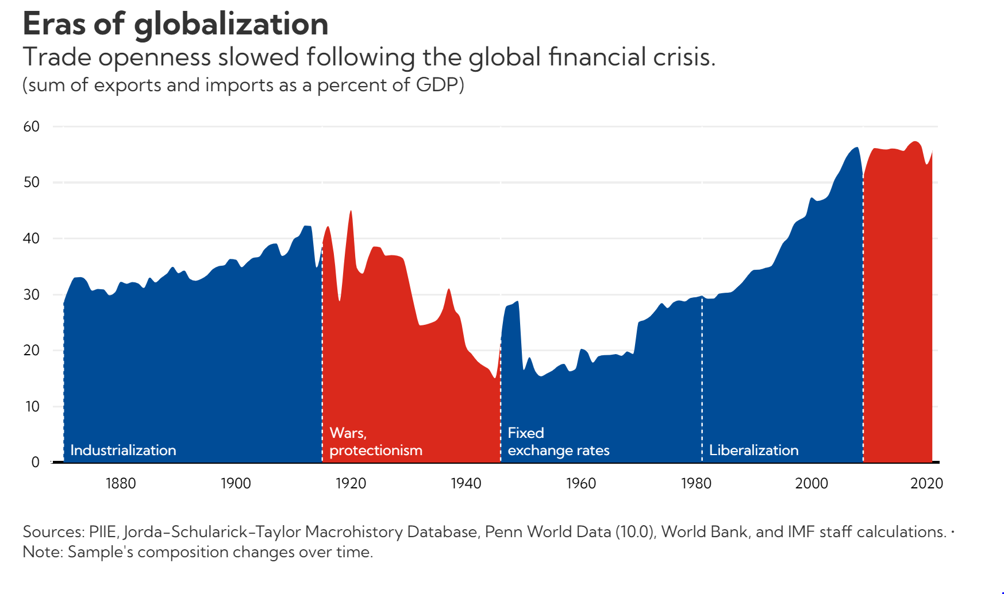
Investing in turbulent times
WE ARE AT AN INFLECTION POINT IN GLOBALIZATION – DECOUPLE, DERISK OR DIVERSIFY
Source: World Bank

Slide 5
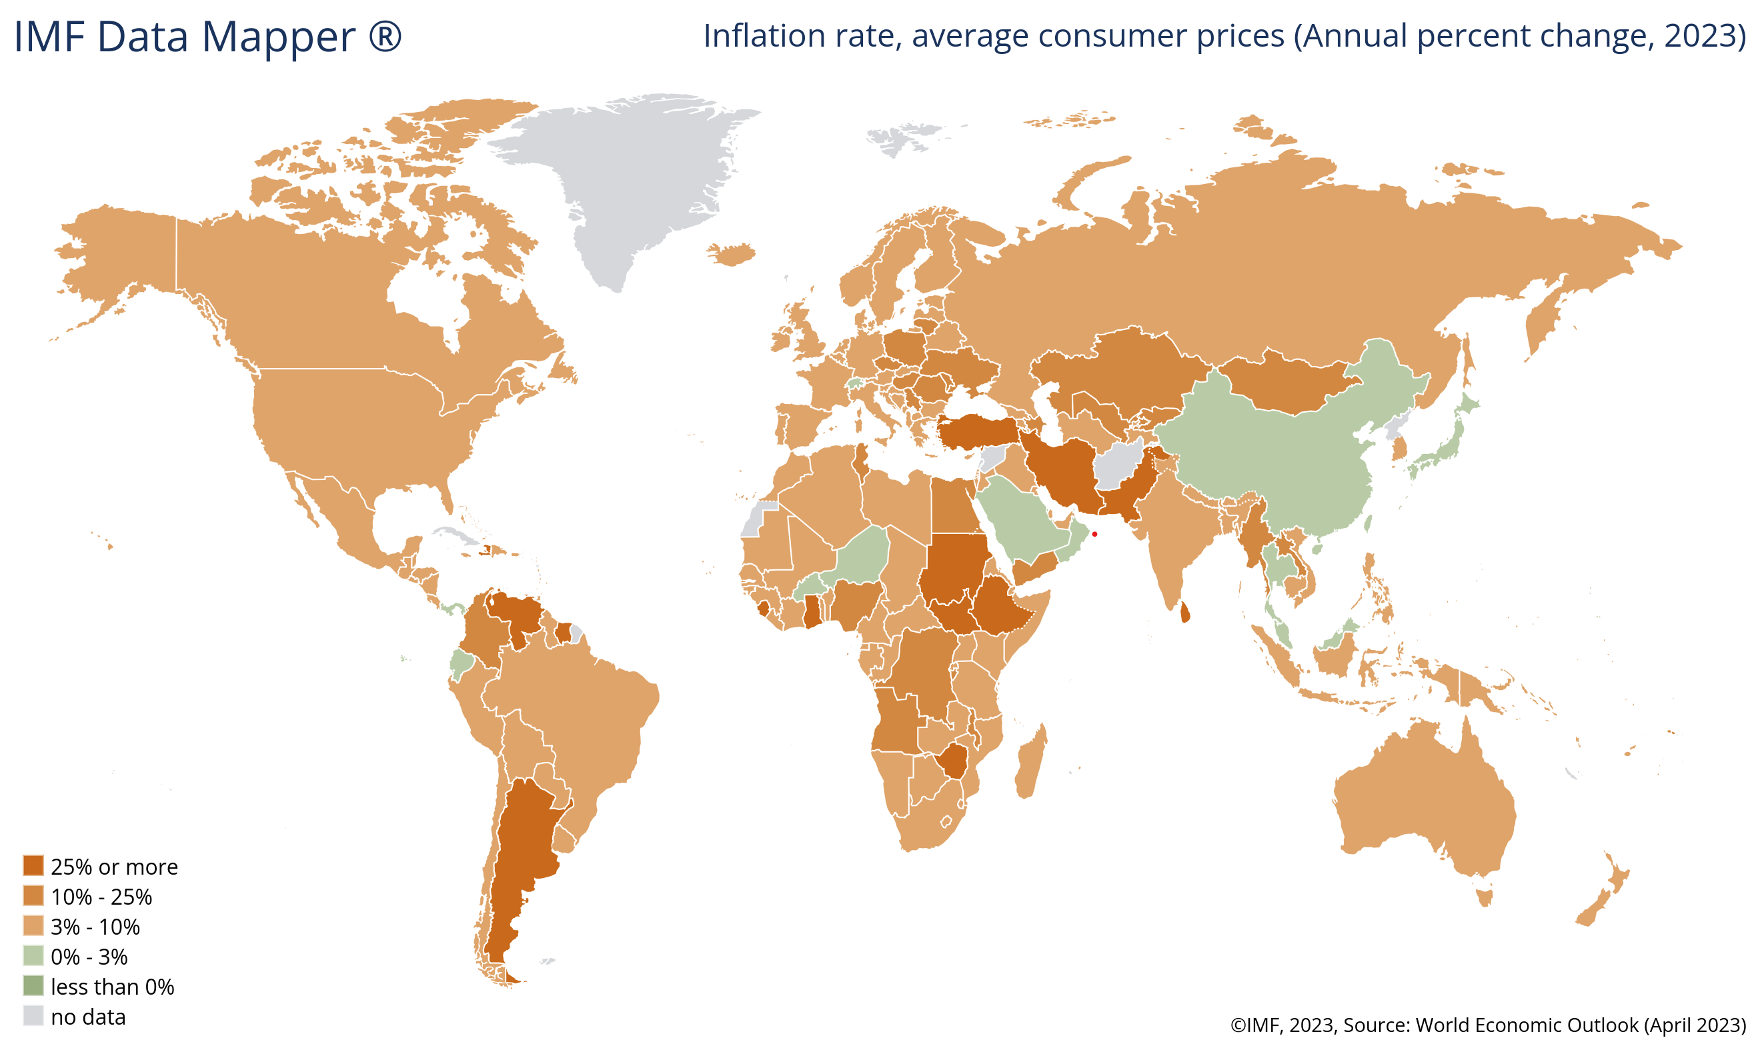
INVESTING IN TURBULENT TIMES
INFLATION REMAINS WELL ABOVE TARGET
Source: International Monetary Fund, April 2023

Slide 6
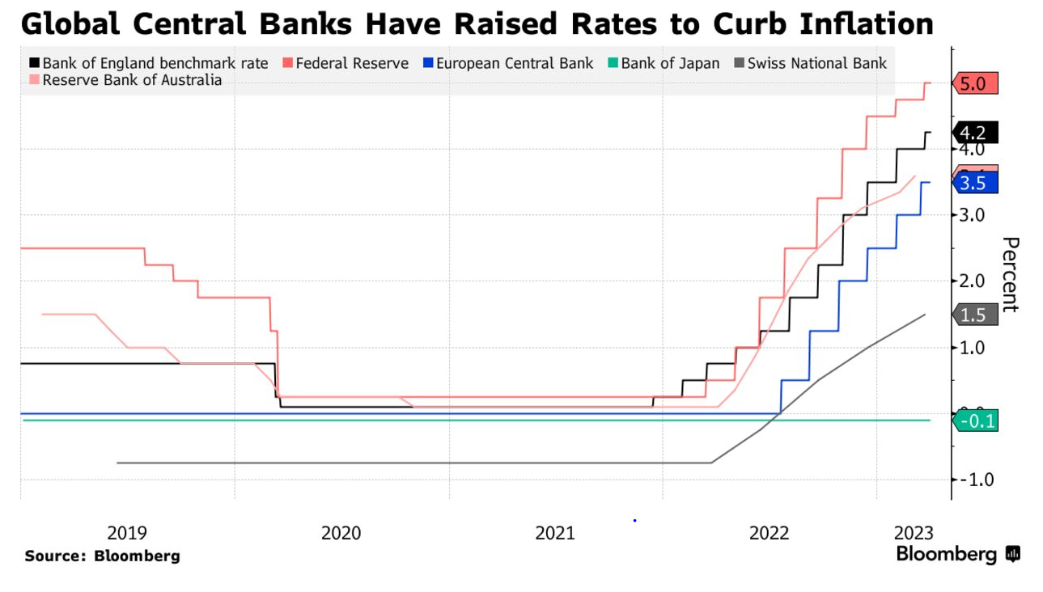
Investing in turbulent times
INFLATION IS PUSHING GLOBAL RATES TO 15-YEAR HIGHS
Source: Bloomberg

Slide 7
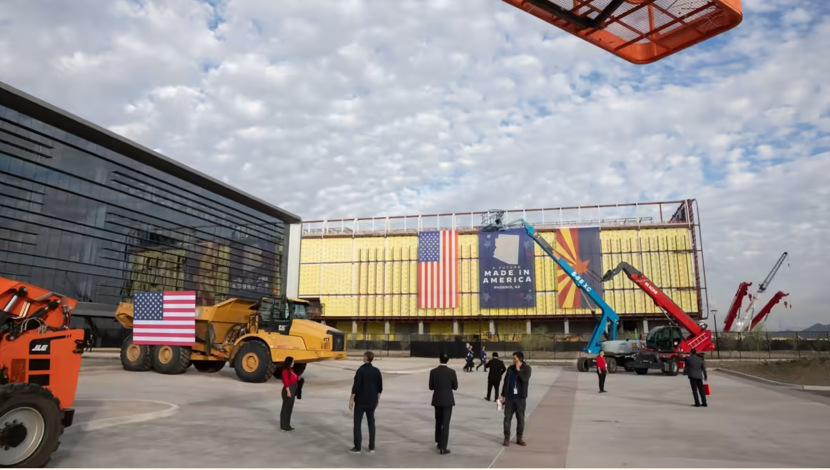
Investing in turbulent times
THE REINDUSTRIALIZATION OF THE GLOBAL ECONOMY

Slide 8
Investing in turbulent times
POLICY IS DEFINING THE INVESTMENT OPPORTUNITIES AND COMPETITIVENESS Government incentive schemes driving capital flows China has long defined its strategically vital industries in its 5-year plans United States policy response has been impressive - Infrastructure Act - Inflation Reduction Act - CHIPS and Science Act - National Defense Authorization Act

Slide 9
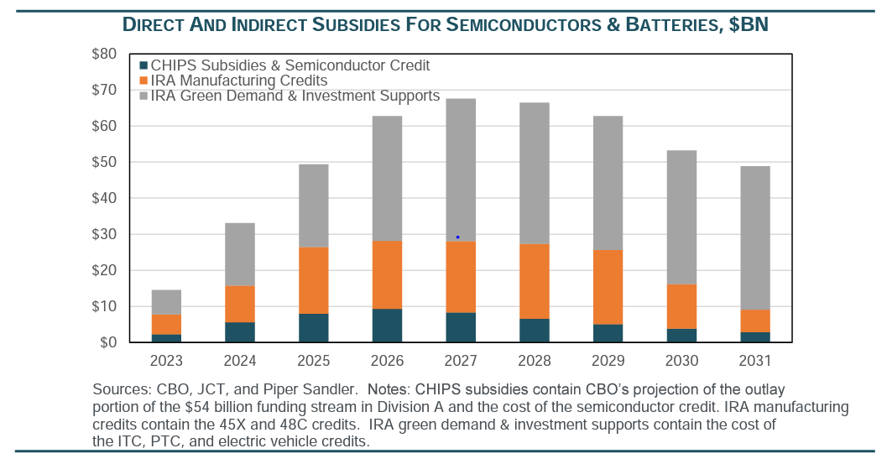
Investing in turbulent times
INDUSTRIAL AND MILITARY POLICIES DRIVING INVESTMENTS IN CRITICAL ECONOMIC AND NATIONAL SECURITY RELATED AREAS
Source: Piper Sandler, CBO and JCT

Slide 10
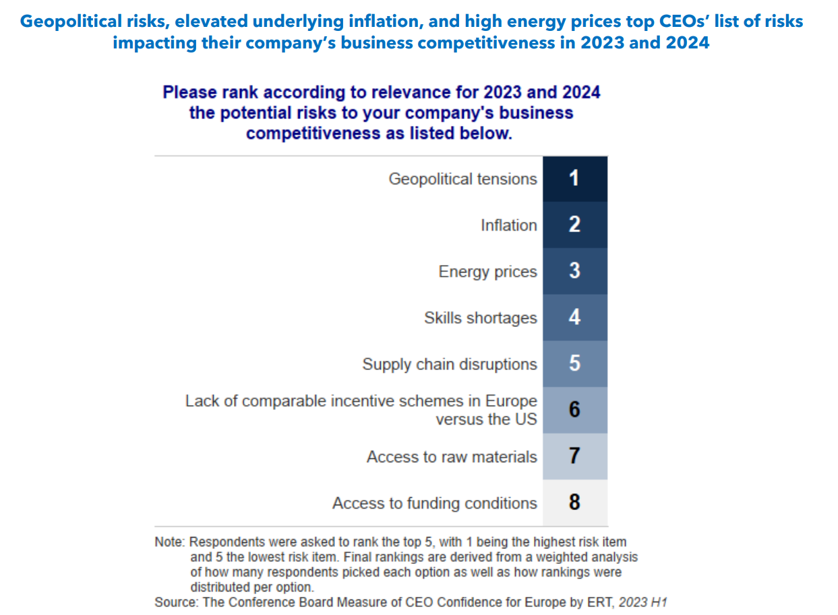
Investing in turbulent times
REINDUSTRIALIZATION - TOP RISKS TO A COMPANY’S COMPETITIVENESS

Slide 11
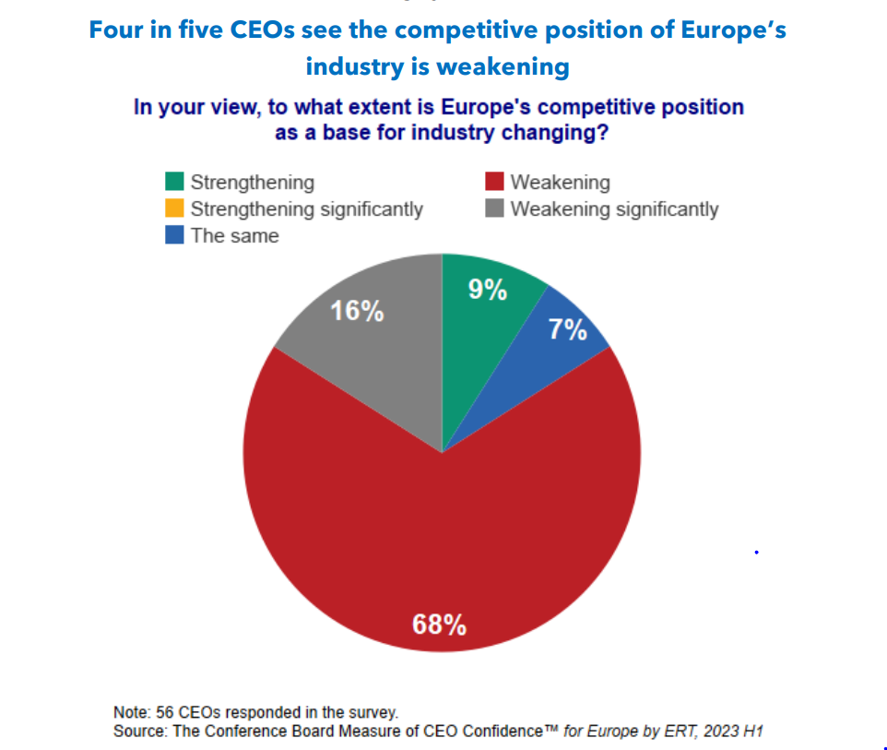
Investing in turbulent times
REINDUSTRIALIZATION IS DRIVING SHIFTS IN SPENDING AND INVESTMENT

Slide 12
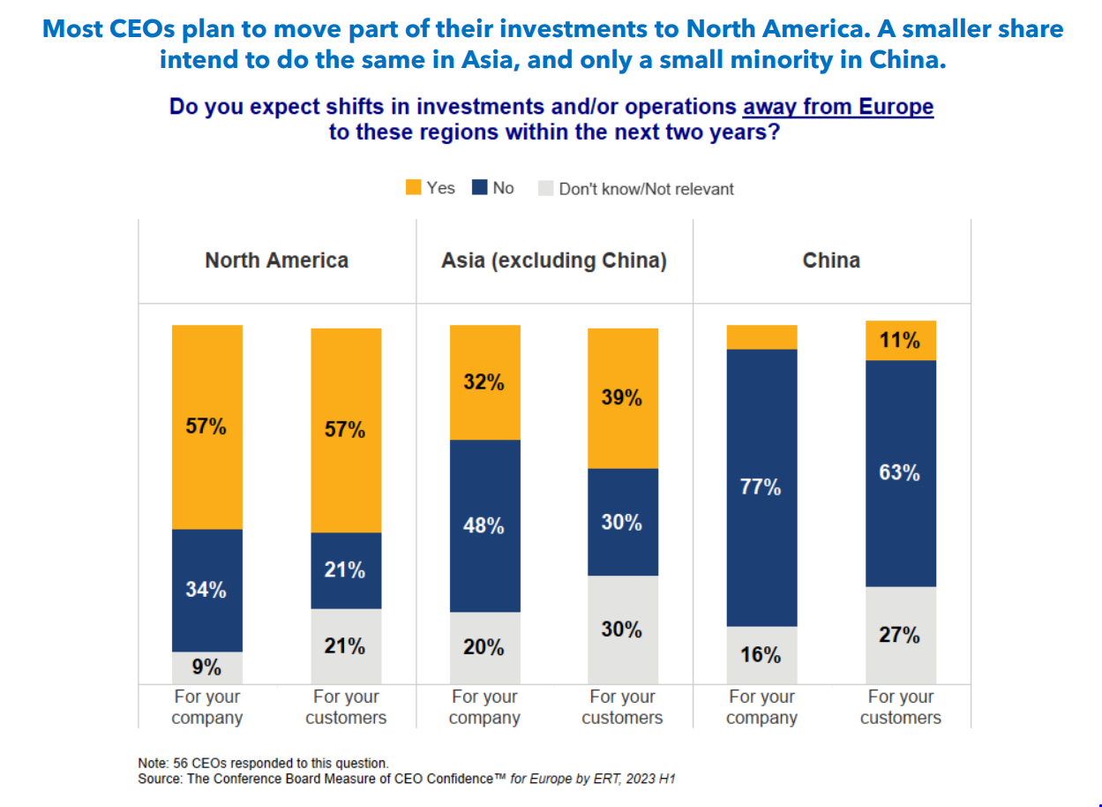
Investing in turbulent times
NORTH AMERICA IS THE PRIMARY BENEFICIARY OF THE SHIFT

Slide 13
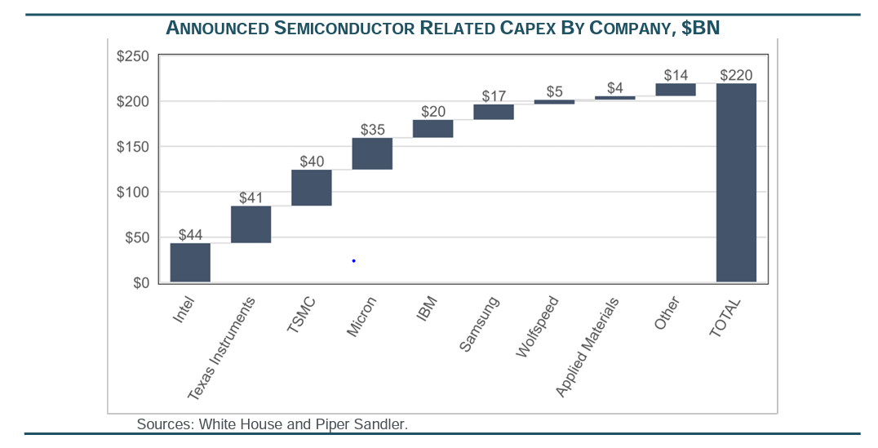
Investing in turbulent times
SEMICONDUCTOR COMPANIES ARE SPENDING TO BENEFIT FROM GOVERNMENT INCENTIVES AND MANAGE GEOPOLITICAL BACKDROP
Source: Piper Sandler

Slide 14
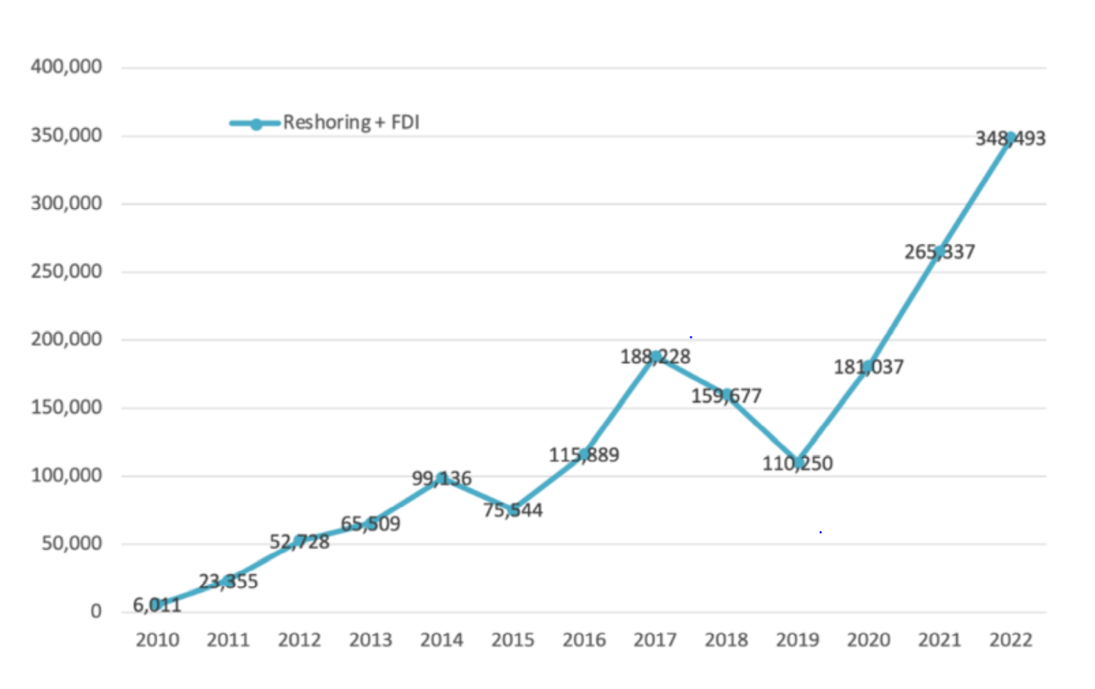
Investing in turbulent times
THESE SHIFTS ARE DRIVING CAPITAL FLOWS AND JOBS ARE COMING BACK TO THE UNITED STATES
Source: Reshoring Institute

Slide 15
Investing in turbulent times
CLIMATE TRANSITION PROVING MORE IMMEDIATE, DIFFICULT AND COSTLY
Source: climatefutureinfo.com

Slide 16
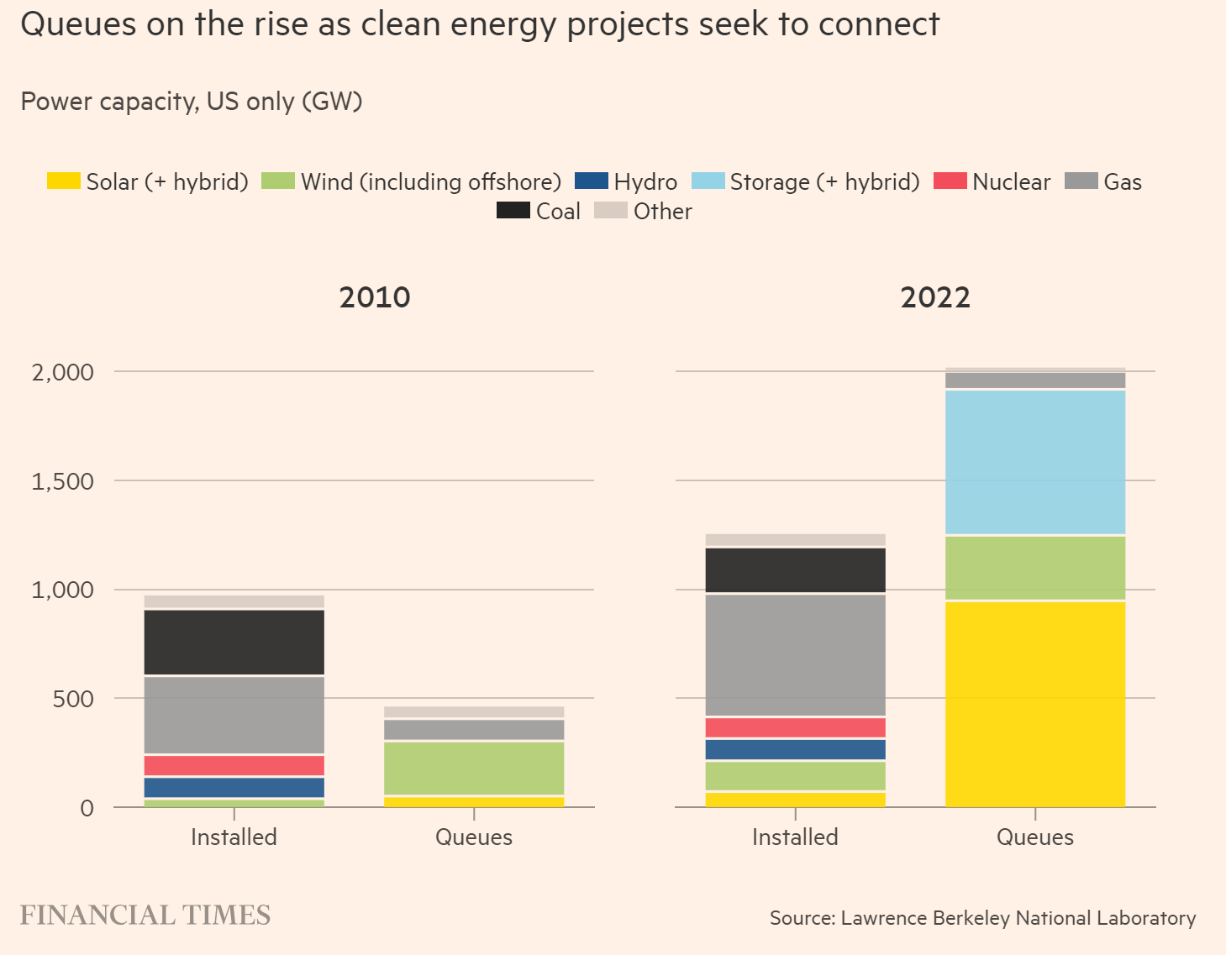
Investing in turbulent times
CLIMATE TRANSITION FACING CHALLENGES – DELAYS OF 5-15 YEARS IN CONNECTING TO GRID FOR APPROVED PROJECTS
Source: Financial Times

Slide 17
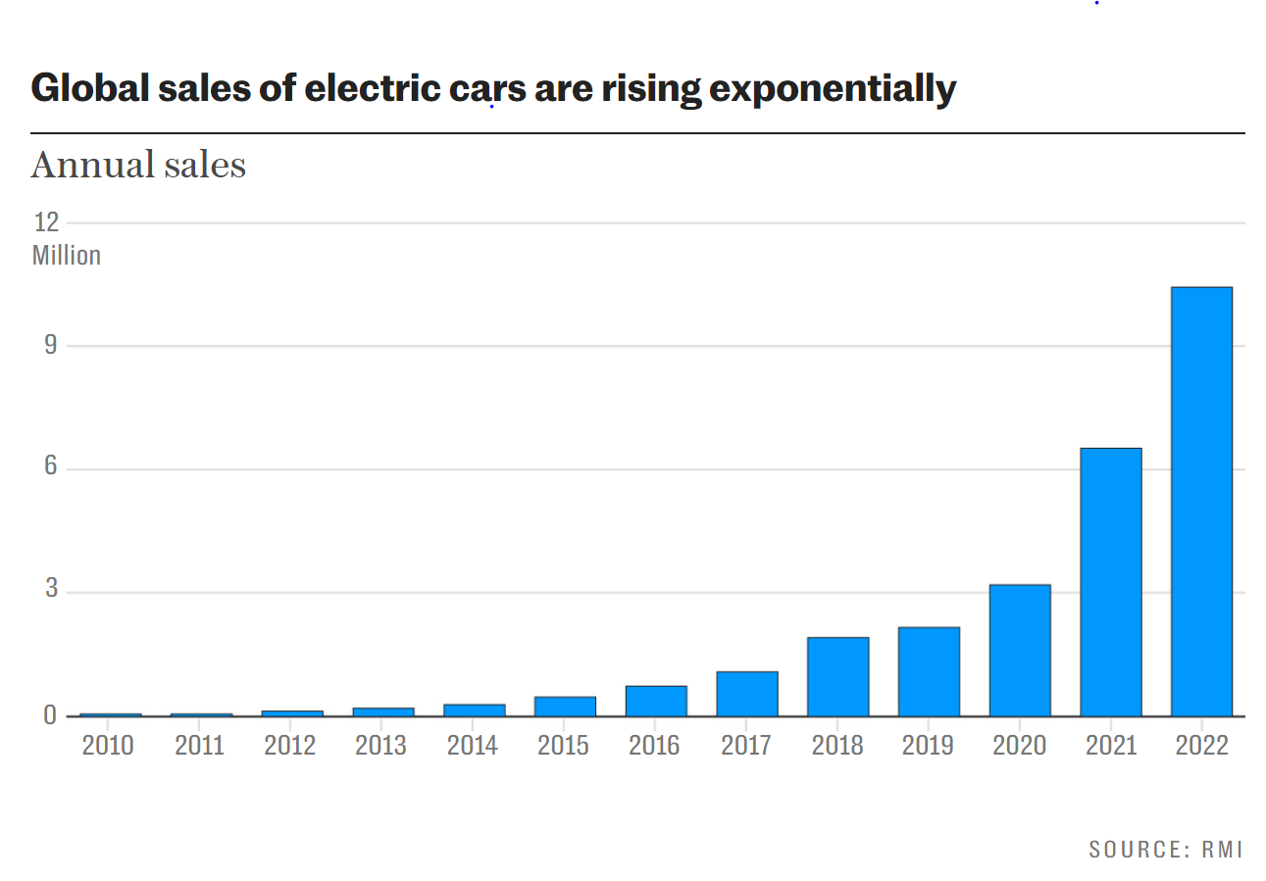
Investing in turbulent times
EXPONENTIAL GROWTH CREATES ITS OWN CHALLENGES
Source: The Telegraph

Slide 18
Investing in turbulent times
ACCESS TO ESSENTIAL RAW MATERIALS IS ANOTHER OBSTACLE
Source: McKinsey

Slide 19
Investing in turbulent times
INVESTMENT IMPLICATIONS OF A CHANGING WORLD

Slide 20
Investing in turbulent times
MARKET RETURNS DRIVEN BY SELECT FEW
Top Performers in S&P 500 YTD
Company | Return (%) |  | Fwd P/E
Nvidia | 206.4% |  | 47.0x
Meta | 145.6% |  | 24.8x
Tesla | 114.3% |  | 75.9x
Broadcom | 60.9% |  | 19.1x
Amazon | 55.3% |  | 61.1x
Apple | 48.5% |  | 29.5x
Oracle | 44.2% |  | 21.0x
Microsoft | 43.9% |  | 30.5x
Alphabet | 36.2% |  | 20.2x
Accounted for over 70% of the S&P 500 Index return year to date
46% of ARS Focused All Cap stocks are trading below the index P/E multiple of 19.0x.
Company | Return (%) |  | Fwd P/E
Cleveland Cliffs | -0.8% |  | 8.3x
Commercial Metals | 13.8% |  | 8.4x
EOG Resources | -4.1% |  | 9.5x
Pioneer Natural Resources | -5.7% |  | 9.6x
Source: Factset

Slide 21
Investing in turbulent times
MANY OF THE MOST IMPORTANT INDUSTRIES NOT WELL REPRESENTED IN STOCK MARKET INDICES
Source: Factset

Slide 22
Investing in turbulent times
MANY CHALLENGES, BUT NEW OPPORTUNITIES DEVELOPING AI is a game changer National security emphasizes domestic industrial policy and energy security Climate transition a challenge and opportunity Reindustrialization of the global economy Credit is attractive again with higher yields

Slide 23
Investing in turbulent times
PARTICIPANT QUESTIONS Q&A

Slide 24
ACA Verification report
Verification Report
ARS Investment Partners, LLC
We have verified whether ARS Investment Partners, LLC (the “Firm”) has, for the periods f rom January 1, 2000 through December 31, 2021, established policies and procedures for complying with the Global Investment Performance Standards (GIPS®) related to composite and pooled fund maintenance and the calculation, presentation, and distribution of performance that are designed in compliance with the GIPS standards, as well as whether these policies and procedures have been implemented on a firm-wide basis. GIPS® is a registered trademark of CFA Institute. CFA Institute does not endorse or promote this organization, nor does it warrant the accuracy or quality of the content contained herein.
The Firm’s management is responsible for its claim of compliance with the GIPS standards and the design and implementation of its policies and procedures. Our responsibilities are to be independent from the Firm and to express an opinion based on our verification. We conducted this verification in accordance with the required verification procedures of the GIPS standards, which includes testing performance on a sample basis. We also conducted such other procedures as we considered necessary in the circumstances.
In our opinion, for the periods from January 1, 2000 through December 31, 2021, the Firm’s policies and procedures for complying with the GIPS standards related to composite and pooled fund maintenance, as well as the calculation, presentation, and distribution of performance, have been, in all material respects:
Designed in compliance with the GIPS standards, and
Implemented on a firm-wide basis.
This report does not relate to or provide assurance on any specific performance report of the Firm or on the operating effectiveness of the Firm’s controls or policies and procedures for complying with the GIPS standards.
ACA Group, Performance Services Division
November 15, 2022

Slide 25
DISCLOSURE NOTES
Past performance is not indicative of future results.
Definition of the Firm – ARS Investment Partners, LLC (“ARS”) was originally founded as A.R. Schmeidler & Co., Inc. in 1971 and is majority-owned by Artemis US Corporation. Artemis US Corporation is 100% owned by Artemis Corporation, an Ontario, Canada entity, which is in turn 100% owned by Artemis Investment Management Corporation, a financial services firm headquartered in Toronto, Ontario, Canada. Mr. Miles Nadal is the controlling shareholder of Artemis Investment Management Corporation. ARS is a registered investment adviser under the Investment Advisers Act of 1940. ARS claims compliance with the Global Investment Performance Standards (GIPS). ARS has been independently verified for the periods 1/1/2000 through 12/31/21. A firm that claims compliance with the GIPS standards must establish policies and procedures for complying with all the applicable requirements of the GIPS standards. Verification provides assurance on whether the firm's policies and procedures related to composite and pooled fund maintenance, as well as the calculation, presentation, and distribution of performance, have been designed in compliance with the GIPS standards and have been implemented on a firm-wide basis. Verification does not provide assurance on the accuracy of any specific performance report. Benchmark returns are not covered by the report of independent verifiers.
The information in this document is believed to be correct at the time of compilation, but no warranty of accuracy or reliability is given and no responsibility arising in any other way for errors and omissions (including responsibility to any person by reason of negligence) is accepted by ARS its officers, employees or agents. The information contained herein is current as of the date hereof but may become outdated or subsequently may change. ARS does not undertake any obligation to update the information contained herein in light of later circumstances or events. This document contains general information only and is not intended to be relied upon as a forecast, research, investment advice, or a recommendation, offer or solicitation to buy or sell any securities or to adopt any investment strategy. Nothing in this presentation constitutes financial, legal, or tax advice. This information is property of ARS and is intended only for intended recipients and their authorized agents and representatives and may not be reproduced or distributed to any other person without prior written consent. Any distribution to social media is a willful violation of the confidential and regulatory strictures that govern this document.
The information contained herein is not warranted to be accurate, complete, or timely. Other data provided may be based upon information received from third parties which is believed to be accurate, but no representation is made that the information provided is accurate and complete. Please be sure to refer to your custodial account statement(s) as the true and accurate record of your portfolio holdings and transactions.
GIPS® is a registered trademark of CFA Institute. CFA Institute does not endorse or promote this organization, nor does it warrant the accuracy or quality of the content contained herein.
All data is subject to change.
Not FDIC-Insured. Not Bank-Guaranteed. May Lose Value.

